Slide 1
REFACTORING
Naveera Sami

Slide 2
Reengineering = Reverse engineering
+Δ+
Forward engineering.

Slide 3
To manage legacy systems, a number of options are available.
Some commonly chosen options are as follows:
Freeze. An organization decides to perform no further work on a legacy system. This implies that either the services of the system are no longer needed or a new system completely replaces a legacy system.
Outsource. An organization may decide that supporting legacy software—or for that matter any software—is not its core business. As an alternative, it may outsource the support service to a specialist organization.
Carry on maintenance. In this approach, the organization continues to maintain the system for another period of time, despite all the difficulties in doing so.
Discard and redevelop. In this approach, the application is redeveloped once again from scratch, using new hardware and software platforms, new software architecture and databases, and modern tools. When the new system is available, the legacy system is simply discarded.

Slide 4
Wrap. In this approach, a legacy system is wrapped around with a new software layer, thereby hiding the unwanted complexity of the existing data, individual programs, application systems, and interfaces.
Migrate. In this approach, an operational legacy system is moved to a new hardware and/or software platform, while still retaining the legacy system’s functionality. The idea is to minimize any disruption to the existing business environment.

Slide 5
Refactoring means performing changes to the structure of software to make it easier to comprehend and cheaper to make subsequent changes without changing the observable behavior of the system. A similar idea for non-object-oriented systems is called restructuring.

Slide 6
He who rejects change is the architect of decay. The only human institution which rejects progress is the cemetery.
—Harold Wilson

Slide 7
Refactoring is achieved through removal of duplicate code, simplification of code, and moving code to a different class, among others. Without continual refactoring, the internal structure of software will eventually deform beyond comprehension, due to periodic maintenance. Therefore, regular refactoring helps the system to retain its basic structure.

Slide 8
In an agile software methodology, such as eXtreme Programming (XP), refactoring is continuously applied to: (i) make the architecture of the software stable; (ii) render the code readable; and (iii) make the tasks of integrating new functionalities into the system flexible.

Slide 9
An important characteristic of refactoring is that it must preserve the “observable behavior” of the system. Preservation of the observable behavior is verified by ensuring that all the tests passing before refactoring must pass after refactoring.
Regression testing is used to ensure that the system did not deviate from the original

Slide 10
ACTIVITIES IN A REFACTORING PROCESS
To restructure a software system, programmers follow a process with well defined activities. Those activities are as follows:
Identify what to refactor.
Determine which refactorings should be applied.
Ensure that refactoring preserves the software’s behavior.
Apply the refactorings to the chosen entities.
Evaluate the impacts of the refactorings. Maintain consistency.

Slide 11
1. Identify What to Refactor
In this step, the programmer identifies what to refactor from a set of software artifacts.
Some examples of software artifacts that the programmer can consider are source code, design documents, and requirements documents. Having identified the top level artifact, the programmer can focus on specific portions of the chosen artifact for refactoring.
Specific modules, functions, classes, methods, and data structures can be identified from the source code for refactoring. For programs written in non object-oriented languages, restructuring is generally limited to the level of a function or a block of code. For programs written in object-oriented languages, the richness of the languages, namely, interfaces, dynamic binding, subtyping, overriding, and polymorphism, make restructuring difficult.

Slide 12
1. Identify What to Refactor contd..
The broad concept of code smell is applied to source code to detect where refactorings should be applied. A code smell is any symptom in the source code of a software that possibly indicates a deeper problem. Existence of code smells in source code do not imply the existence of problems in source code, such as, faults, low level of performance, and low level of reliability.
On the other hand, what code smells do imply is that if the problems are not resolved sooner, then it is likely that future changes may introduce more faults and future changes may be more expensive to execute. Some examples of code smells are as follows.

Slide 13
Duplicate Code: This smell occurs when segments of source code are repeated in many places in the program. If there is a need to change the duplicate code, it must be ensured that all segments are changed. If some segment is missed, which is likely to occur, then faults will be introduced. The solutions lie in the nature of code duplications. For example, if duplications occur in different methods of the same class, then duplicates can be extracted into a new method. On the other hand, if duplicate methods occur in subclasses, then the duplicate codes can be moved to the subclass. In simple cases, code duplication can be eliminated by introducing a new function and by inserting function calls. In complex cases, an intermediate subclass can be inserted to factor out the common code

Slide 14
Long Parameter List: When a method has too many formal parameters, say, more than four, programmers may make errors while designing calls to the method. A common error is to reorder the list of actual parameters. A solution may be found in designing a parameter object, thereby passing a single parameter instead of a long list of parameters.
Long Methods: This occurs if a method has a long sequence of statements, say, hundreds of lines of code. A solution lies in extracting methods from long fragments of cod

Slide 15
Large Classes: A smell is said to occur if a class has too many methods, say, more than 8, and too many variables, say, more than 15. A solution lies in splitting the class into component classes and creating super classes.
Message Chain: A message chain occurs when one calls several methods successively. An example of a message chain is: student.getID().getRecord() .getGrade(course). Such a chain can be simplified by means of a helper function that performs part of the computation of another function. Thus, the above message chain can be rewritten as: student.getGrade(course).

Slide 16
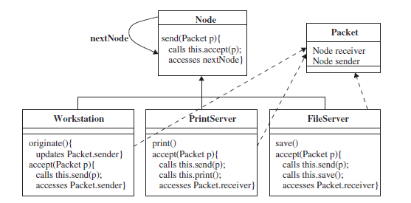
2.Determine Which Re factorings Should be Applied
In this step, the programmer identifies which refactoring to apply to the portions of the software identified in the aforementioned first step. For ease of understanding, in

Slide 17


Slide 18
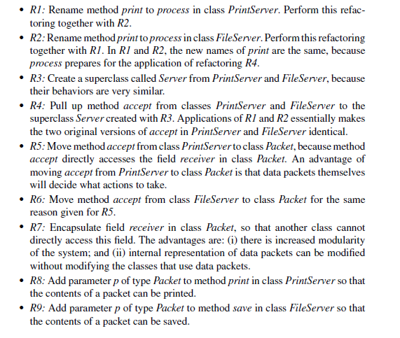

Slide 19
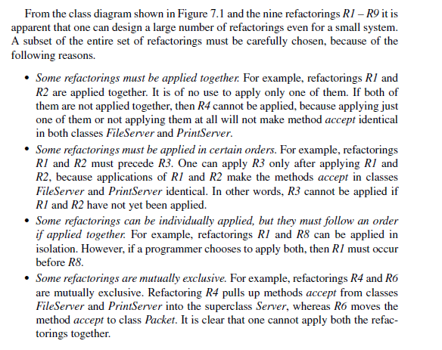

Slide 20
